Slide 1
Cerebras CS-2: the AI Compute Engine for Neocortex
December 6th, 2024
Notes:
CS-2 intro (10 min)
How to program CS-2: ML (25 min)
Integration with TF and PyT
Walk through reference implementations and public docs, supported layers
Past examples of successful projects (GSK, AZ, FSI)
Topics of interest to Cerebras/Neocortex
How to program CS-2: HPC (10 min)
SDK and CSL overview
Past examples of successful projects (Total)
Topics of interest to Cerebras/Neocortex

Slide 2
CS-2 Overview

Slide 3

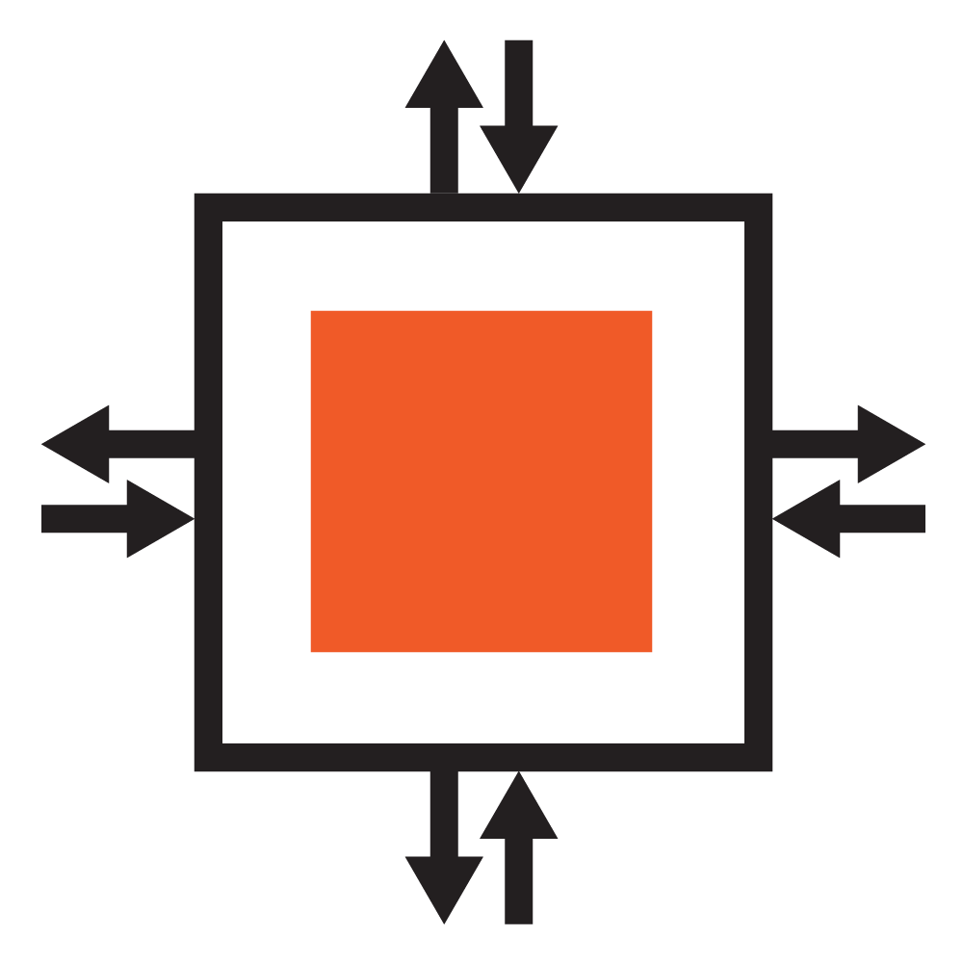

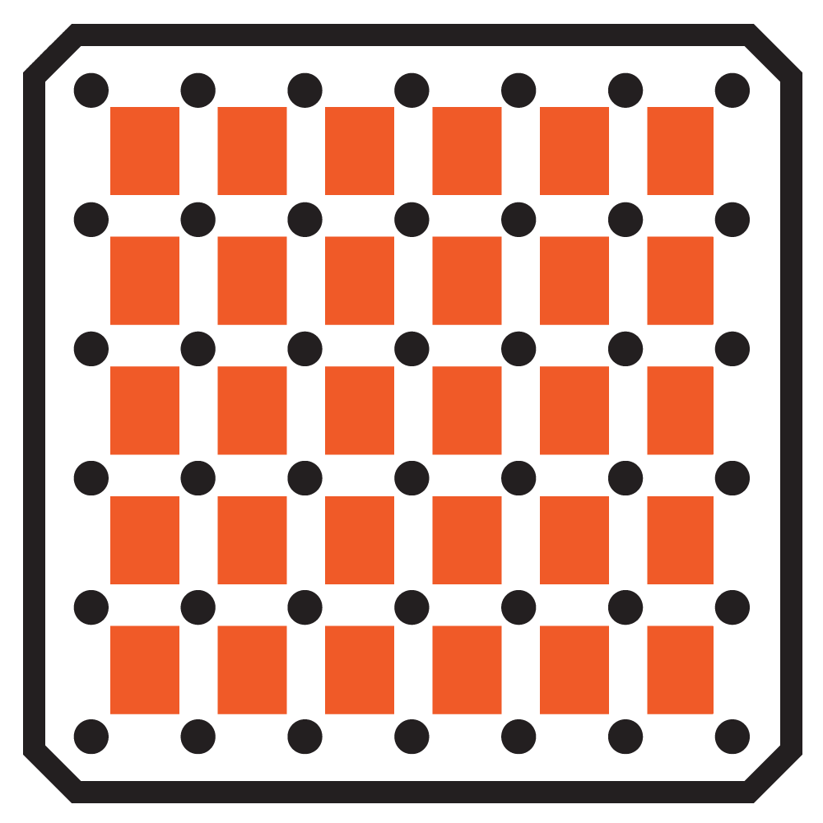
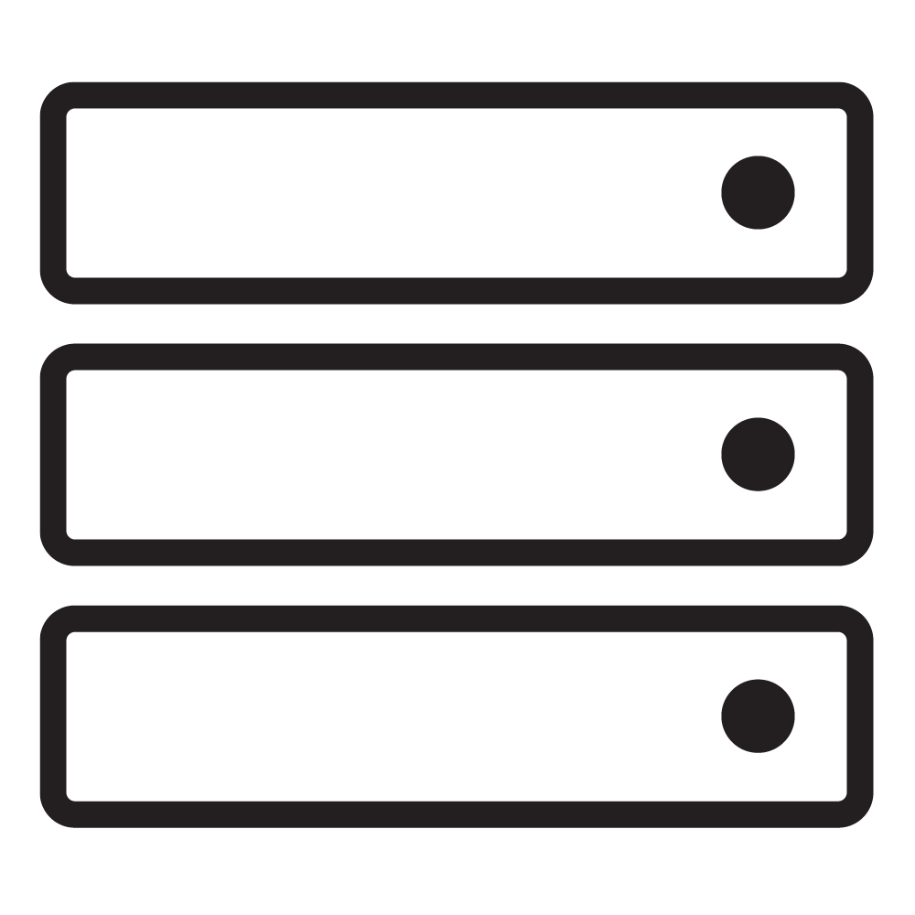
System Hierarchy
PE
Wafer
CS-2
Neocortex
Networked File Storage
Superdome Flex
Fabric
Compute
Memory
Chief
Input Workers
Notes:
The system hierarchy starts with the smallest component, the processing element. They PEs together compose the Wafer, which powers the CS-2 system
At Neocortex
The two CS-2s are connected to the SuperdomeFlex system partitioned to two nodes.
The SDF contains the chief and input worker nodes.
And it is connected to a file storage system.

Slide 4
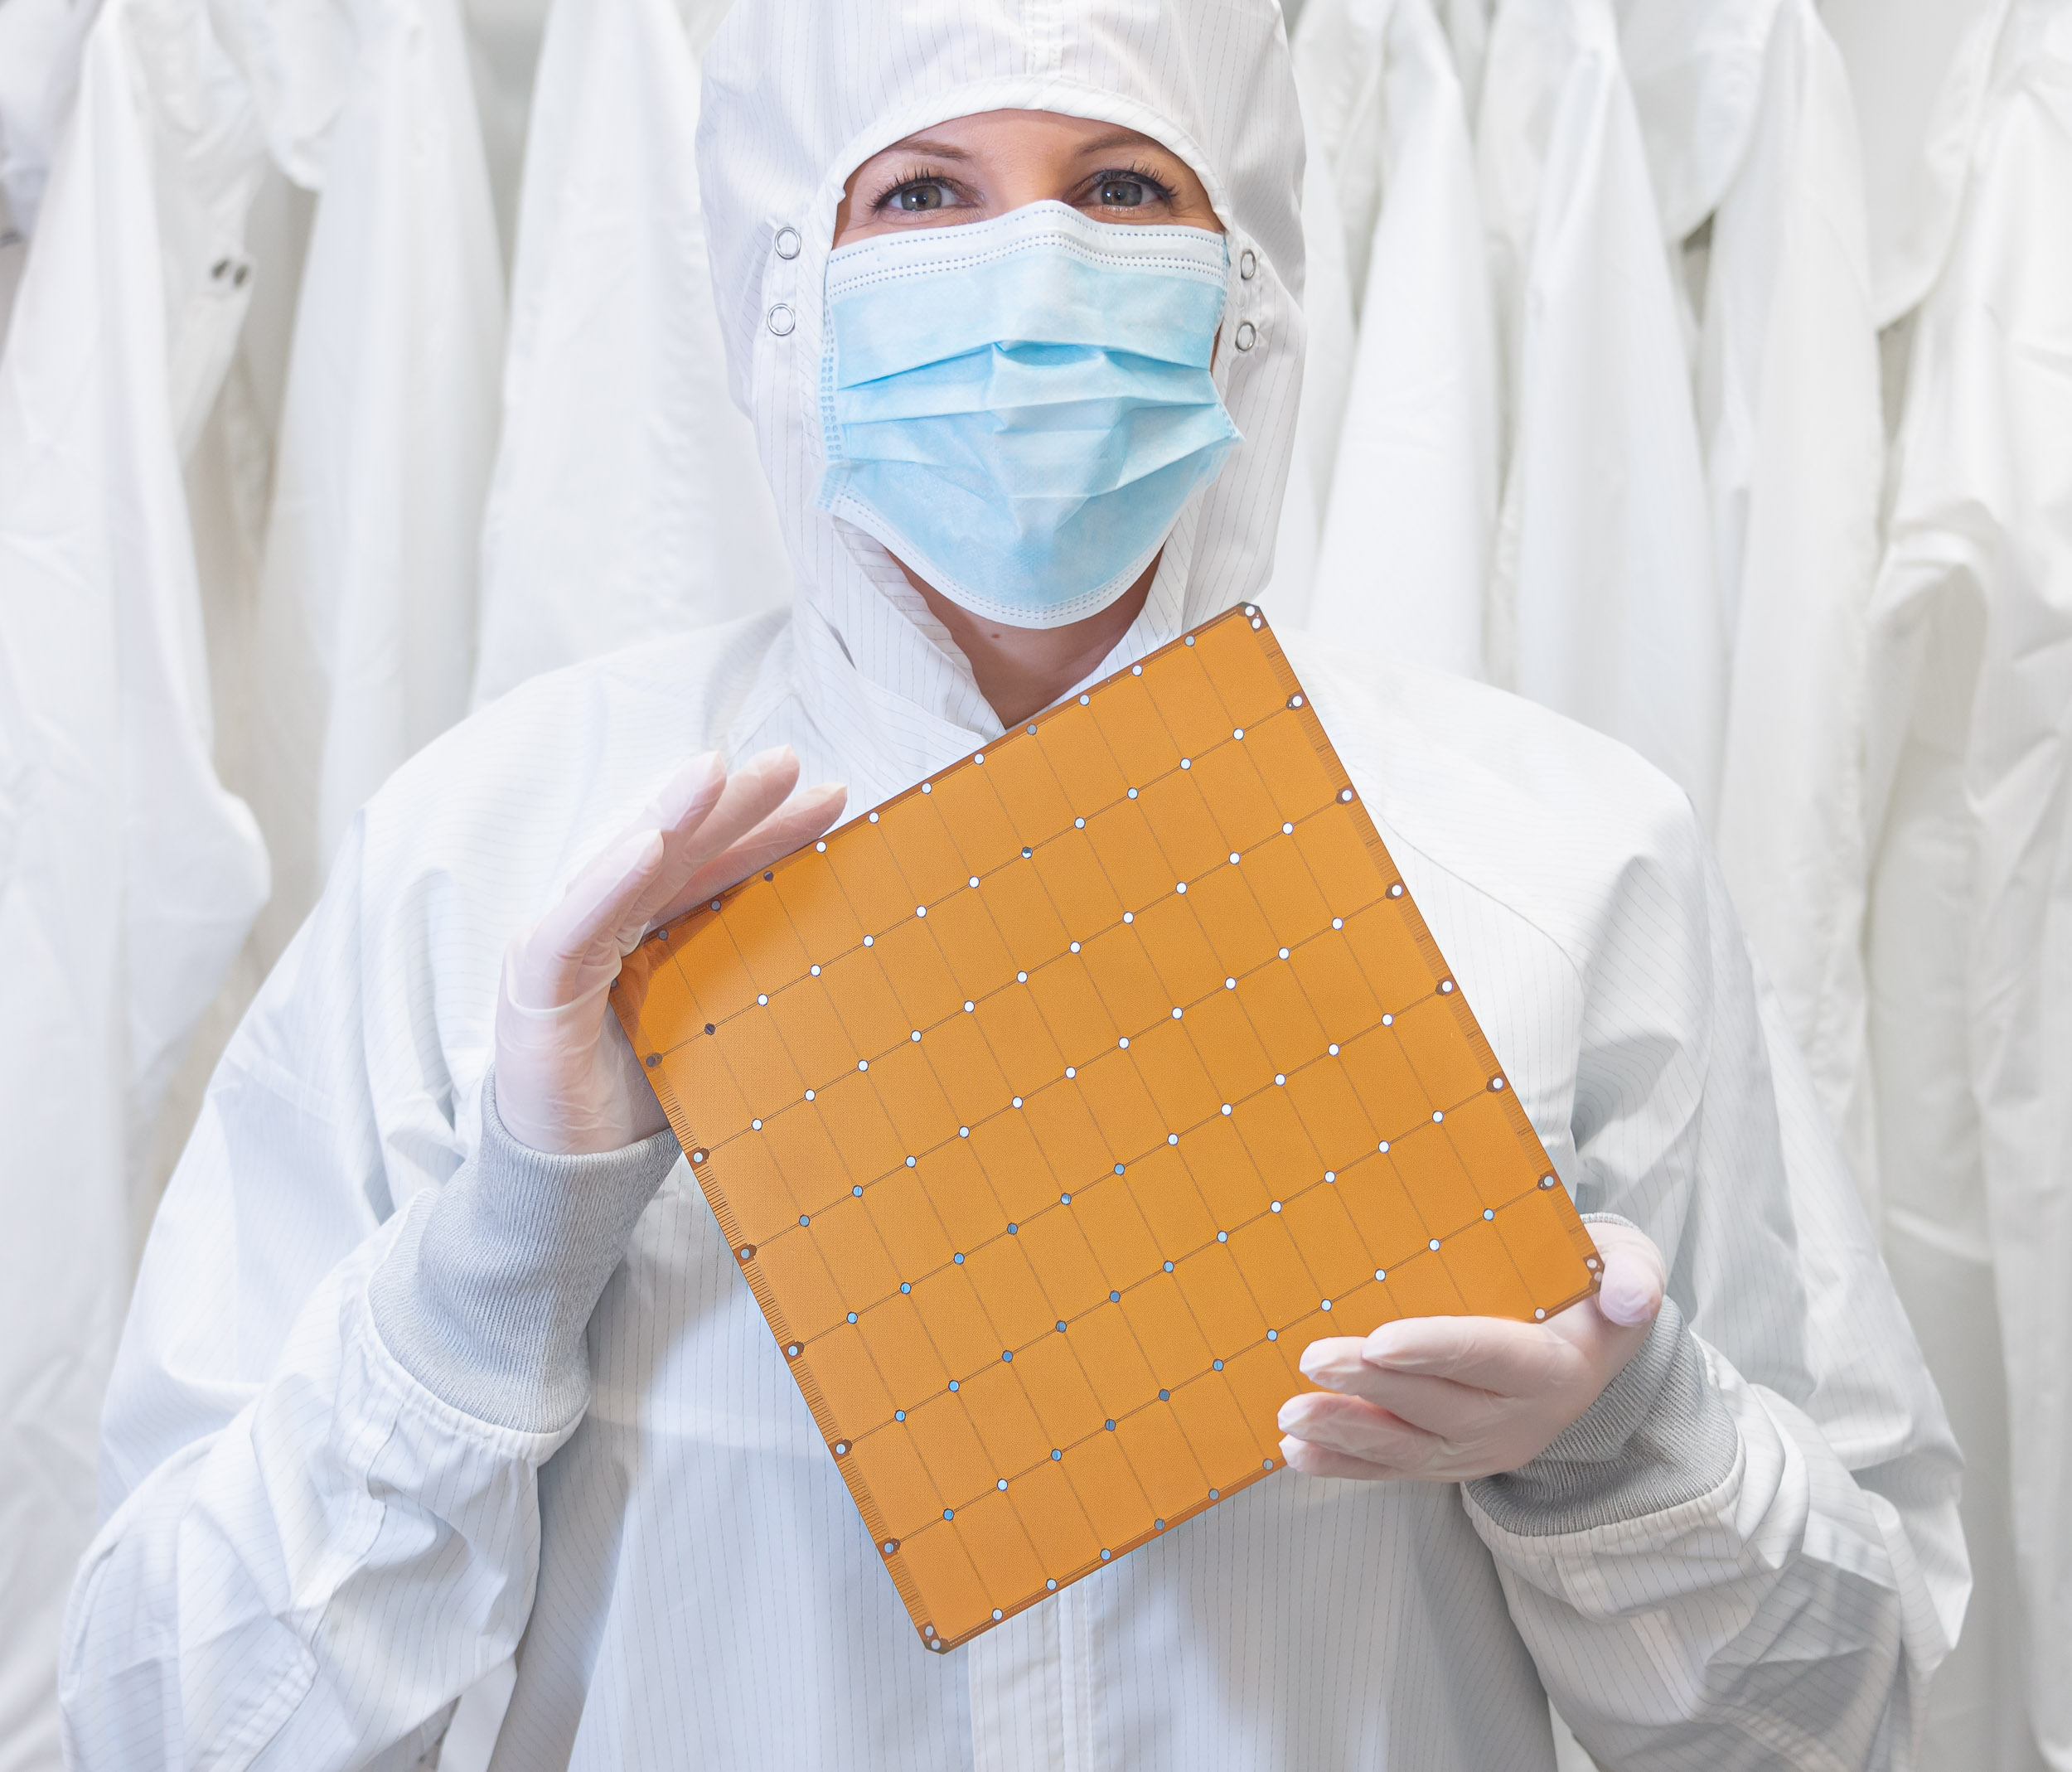
Cerebras Wafer Scale Engine (WSE-2)
850,000 cores optimized for sparse linear algebra
46,225 mm² silicon
2.6 trillion transistors
40 Gigabytes of on-chip memory
20 PByte/s memory bandwidth
220 Pbit/s fabric bandwidth
7nm process technology
Cluster-scale performance in a single chip
Notes:
Our chip, the Cerebras Wafer Scale Engine, is a power processor for AI and HPC applications
It’s the largest processor chip built using a single piece of silicon
It’s over 46,000 square-mms in size and contains 2.6 trillion transistors
All powering 805,000 AI-optimized cores
And the Wafer Scale Engine is the heart of the [click] Cerebras CS-2 system

Slide 5

Deployment and job execution within Neocortex
CS-2 is a network-attached accelerator
Cerebras software runs on CS-2 and on the SuperdomeFlex
  Chief compiles the code and manages CS-2
  Input workers read data, run the input pipeline, and stream data to CS-2
Loss output, summaries, checkpoints are streamed from CS-2 to SuperdomeFlex
Jobs are managed by slurm
Networked File Storage
Input Workers
Chief process
SuperdomeFlex
Notes:
Cerebras’ SW runs on a standard server anywhere in your infrastructure
TF training graph is compiled on the TF Master generating a config for the CS-2 HW
Workers are standard servers or DFS running TF and hosting CS data agents
Worker servers pull/process input data from storage and stream data to CS-2
-------
Regarding how deployment and job execution works within neocortex

Slide 6
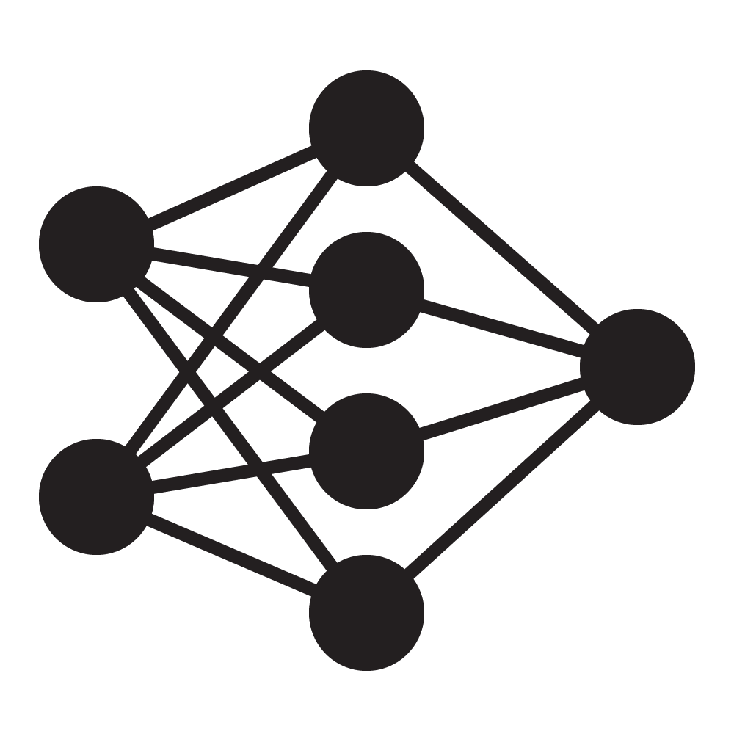


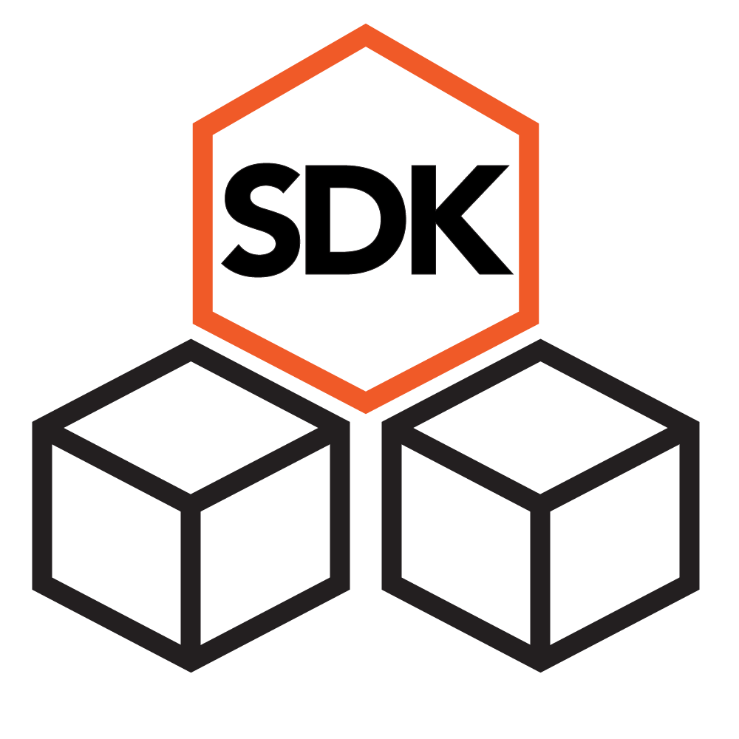
Developer Resources
*please refer to the Original Cerebras Installation version/sections for both the Model Zoo repository and Software Documentation
For ML developers
Cerebras Model Zoo repository
(https://github.com/Cerebras/modelzoo/tree/original_cerebras_installation)
Cerebras ML Software Documentation
(Original Cerebras Installation sections of https://docs.cerebras.net/en/latest/original/index.html)
For HPC developers
Cerebras SDK
Notes:
We have developer resources to help you understand and use our system
For ML developers, we have a Cerebras modelzoo repository, which covers our reference implementations of many popular model architectures
We also have our ML sotware documentation, with detailed explanations of our sytem, what we support, how to build your project on the CS-2
To match the versions supported at Neocortex, please start with the original cerebras installation version or sections for both the modelzoo and software documentation

Slide 7
CS-2 for Deep Learning
Notes:
PyTorch and TF integration
Reference implementations, docs, supported layers
Examples of successful DL projects
DL Topics of interest to Cerebras/Neocortex
---
Moving onto CS-2 for deep learning

Slide 8


Supported Frameworks
TensorFlow
PyTorch
Class:
CerebrasEstimator
Based on TF Estimator, takes over executions after XLA compilation
TensorFlow 2.2
Python Module:
cerebras.framework.torch
Based on PyTorch XLA
Wrappers for Dataloader, Module, Session
PyTorch 1.11
Notes:
We support two frameworks: TensorFlow and PyTorch
To support TensorFlow, Cerebras has our own wrapper called CerebrasEstimator, which is based on the TensorFlow Estimator, and takes over executions after XLA compilation. We support tensorflow version 2.2
For PyTorch, Cerebras has our own module cerebras.framework.torch, which is based on PyTorch XLA. It is a wrapper for dataloader, model modules, sessions. We support PyTorch 1.11

Slide 9
TensorFlow example
from cerebras.tf.cs_estimator import CerebrasEstimator
from cerebras.tf.run_config import CSRunConfig
def model_fn(features, labels, mode, params);
...
return spec
def input_fn(params):
...
return dataset
est = Estimator(
model_fn,
config=CSRunConfig(cs_ip, params)
params=params,
model_dir='./out',
)
est.train(input_fn, steps=100000)
Notes:
TF 2.2.0

Slide 10
PyTorch example
import torch_xla.core.xla_model as xm
from cerebras.models.common.pytorch.PyTorchBaseModel import PyTorchBaseModel
import torch_xla.distributed.data_parallel as dp
class Model(PytorchBaseModel):
def __init__(self):
Pass
def forward(self, x):
Pass
device = xm.xla_device()
model = Model().to(device)
optimizer = optim.Adam (…)
Use XLA Device instead of GPU/CPU device
Notes:
Torch v1.9, the latest
Uses Pytorch - XLA backend
We use tracing to extract the complete PyTorch graph
Unrolling loops and control statements
Tracing in PyTorch XLA uses lazy tensors
This means nothing is evaluated unless it is needed
Reduce the number of graph updates
Import PyTorch XLA
Import Cerebras PyTorchBaseModel
Define your model and training loop.
Use XLA device instead of of GPU/CPU device from ‘xla_model’
Use: ‘xm.xla_device()’ instead of ‘torch.device(…)’
In your epoch loop, call XLA ‘optimizer_step’
Use: ‘xm.optimizer_step(optimizer)’ instead of ‘optimizer.step()’

Slide 11

How do we translate a model into a CS executable?
?
Framework
CS-2

Slide 12
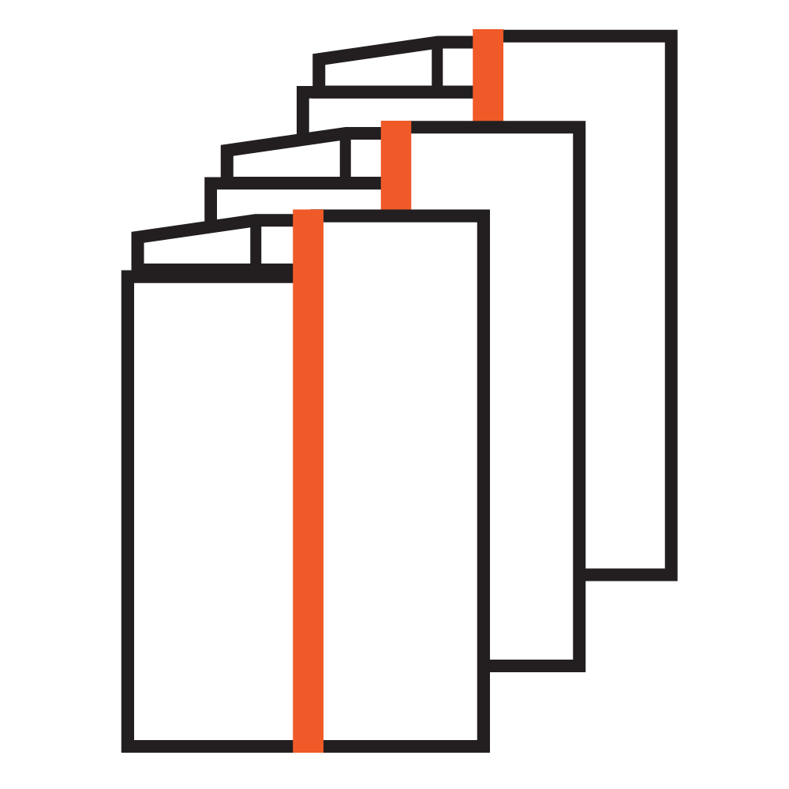
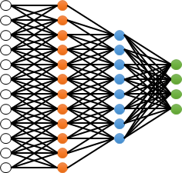
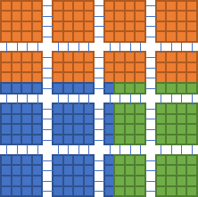
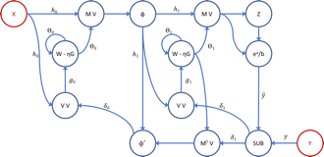
The Cerebras Software Platform
Cerebras Compiler
Feature Support
Extract graph representation of model from framework and match operations with kernel library
Extract
Match
Place
Link
Framework
CIR-H
Kernel graph
Execution plan
Executable
Notes:
With the Cerebras software platform, users can program on the TensorFlow and PyTorch level.
Users don't need to manually extract graphs or call lower-level CS-2 interaction APIs. The compiler automatically maps the Framework graph to an optimized executable for CS-2.
With your TensorFlow and PyTorch code, they will be extracted to Cerebras intermediate representation CIRH. And then the graph representation of the model will be extracted and the operations will be matched with the kernel library.
The Software platform lets users program transparently in TensorFlow and PyTorch
Interface-level integration
Users don’t need to manually extract graphs or call lower-level CS-2 interaction APIs
Customizable and extensible for other applications with lower-level Cerebras SDK (coming soon)
The compiler automatically maps the Framework graph to an optimized executable for CS-2.
No distributed cluster programming required – same execution plan works for 1 or N systems

Slide 13
The Cerebras Software Platform
Cerebras Compiler
Hardware Placement
Assign kernels to regions of fabric and create executable to be run by CS-2.
Extract
Match
Place
Link
Framework
CIR-H
Kernel graph
Execution plan
Executable
Notes:
Afterwards, the kernels will be assigned to regions of the fabric, and executable will be created to run on the CS-2.
---------
The Software platform lets users program transparently in TensorFlow and PyTorch
Interface-level integration
Users don’t need to manually extract graphs or call lower-level CS-2 interaction APIs
Customizable and extensible for other applications with lower-level Cerebras SDK (coming soon)
The compiler automatically maps the Framework graph to an optimized executable for CS-2.
No distributed cluster programming required – same execution plan works for 1 or N systems

Slide 14
The Cerebras Software Platform
Cerebras Compiler
Extract
Match
Place
Link
Framework
CIR-H
Kernel graph
Execution plan
Executable
Program a cluster-scale resource with the ease of a single node
Notes:
There is no distributed cluster programming required. The same exeuction plan works for 1 or several number of systems.
--------
The Software platform lets users program transparently in TensorFlow and PyTorch
Interface-level integration
Users don’t need to manually extract graphs or call lower-level CS-2 interaction APIs
Customizable and extensible for other applications with lower-level Cerebras SDK (coming soon)
The compiler automatically maps the Framework graph to an optimized executable for CS-2.
No distributed cluster programming required – same execution plan works for 1 or N systems

Slide 15
ML Software Key Features
Network Architectures
Transformers (TF and PT)
  E.g., BERT, RoBERTa, AIAYN, T5, GPT
Multi-layer Perceptrons (MLP) (TF and PT)
Experimental (TF only)
  UNet - limited functionality
General features
Supports Train, Eval
Trained weights in standard TF and PT formats
Monitor your runs with TensorBoard
Multi-replica support for smaller models
* Please refer to the Original Cerebras Installation Model Zoo repository for architectures we support.
* We recommend starting from the Model Zoo implementations to build your models.
Notes:
For machine learning software key features
The models we support are largely transformer based, in both tensorflow and pytorch.
We also support multi layer perceptions.
For computer vision, we support an experimental UNet in Tensorflow only.
For other general features, we support traininign and eval. The checkpoints generated are in standard tensorflow and pytorch formats. We support tensorboard and generate tensorboard even files. For smaller model we support multi-replica mode to speed up training.
For a more detailed overview of the features we support, please refer to ….
We highly recommend taking a look and starting from the modelzoo implmentations to build your models

Slide 16
ML topics of Interest
Neocortex is best suited for running transformer-style models
  GPT, LLaMa, T5, BERT, ViT, etc
Notes:
What kind of machine learning applications are best suited to run on CS2?

Slide 17
ML topics of Interest
Neocortex is best suited for running transformer-style models
  GPT, LLaMa, T5, BERT, ViT, etc
Modeling tasks for sequences include:
  Classification - sentiment analysis, molecule properties
  Annotation - extractive summarization, protein binding site identification
  Generation - abstractive summarization, candidate drug generation
  Sequence-to-sequence mapping - Natural language translation, code translation
  Representation learning - biological sequences (genome, epigenome, protein)
  And more!
Notes:
What kind of machine learning applications are best suited to run on CS2?

Slide 18
ML topics of Interest
Neocortex is best suited for running transformer-style models
  GPT, LLaMa, T5, BERT, ViT, etc
Modeling tasks for sequences include:
  Classification - sentiment analysis, molecule properties
  Annotation - extractive summarization, protein binding site identification
  Generation - abstractive summarization, candidate drug generation
  Sequence-to-sequence mapping - Natural language translation, code translation
  Representation learning - biological sequences (genome, epigenome, protein)
  And more!
Using transformers on historically non-transformer workloads:
  Image classification: CNN → ViTs
  Autoregressive sequence modeling: RNN → GPT
  Graph modeling: GNN → BERT with adjacency attention mask
Notes:
What kind of machine learning applications are best suited to run on CS2?

Slide 19
Example Projects/ Models
GSK: new sequence modeling for genetic medicine
  “Epigenomic language models powered by Cerebras” Trotter, 2021
PubMedBERT
  “Domain-specific language model pretraining for biomedical NLP” Gu, 2021
AntiBERTa
  “Deciphering the language of antibodies using self-supervised learning” Leem, 2021
TAPE
  “Evaluating protein transfer learning with TAPE” Rao, 2019
SMILES-BERT
  SMILES-BERT: Large Scale Unsupervised Pre-Training for Molecular Property Prediction" Wang, 2019
Notes:
Here is a list of example projects that can be completed on the CS-2

Slide 20
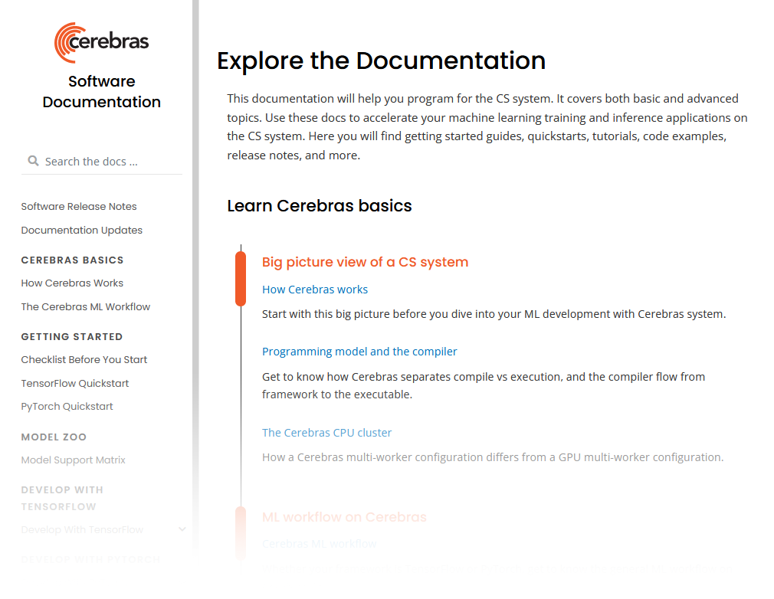
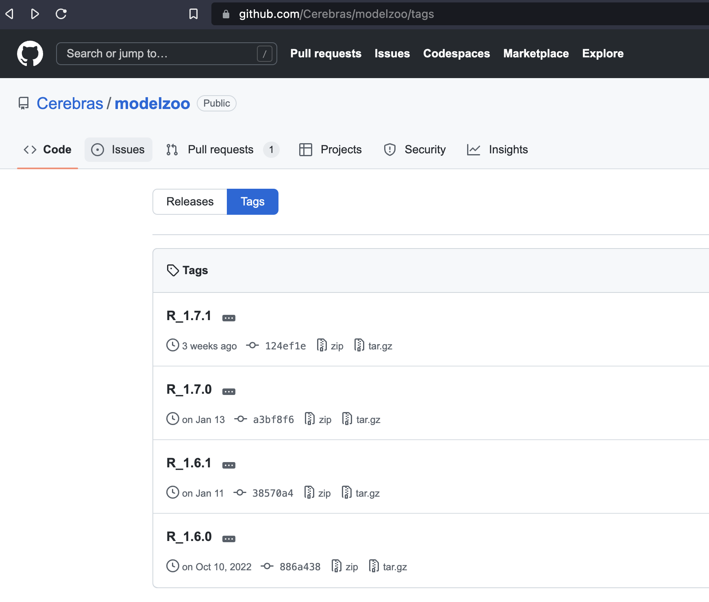
Resources
Documentation: docs.cerebras.net
Cerebras Model Zoo: github repo
Please check out the Original Cerebras Installation version/sections.
Notes:
Finally, we have resources to help you understand and navigate our system

Slide 21
Demo

